Slide 1
Evidence Journal Project 3: Breaking Horizons
Summative
AAD531 Front-end Web Design
Name: Prapti Ankush Mane
Student ID: 13491449
Date: 18/06/2021

Slide 2
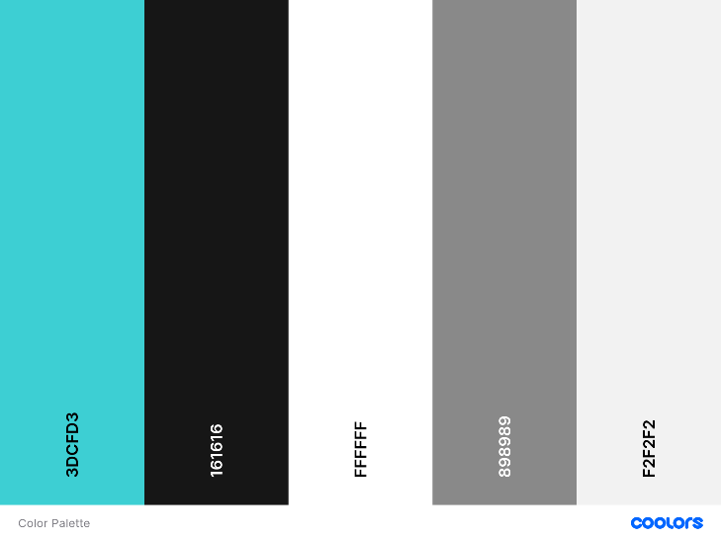
Colour choices
The reason for these colors were approved by the client. She has always used this color even for her visiting cards hence the colors were established by the client. The reason she told me behind these colors is that it is gender neutral. Since my client caters to men, women and children these colors seem ideal choice. The buttons have the border of the turquoise where they’re on a black background as it really helps the button stand out and when you hover over them the background of the button turn completely turquoise. The text on the buttons is in white which is standard throughout the website as somewhere the buttons are on a black background, and you won’t be able to read black text. I have used span on my headers so the text could be colored accordingly. The social media icons have a turquoise hover. Services grid boxes also have a turquoise hover. Since the send message button is on a white background the button is turquoise and the text inside the button is in black, and the hover for that button is white.
I used https://coolors.co/ to generate the color palette.

Slide 3
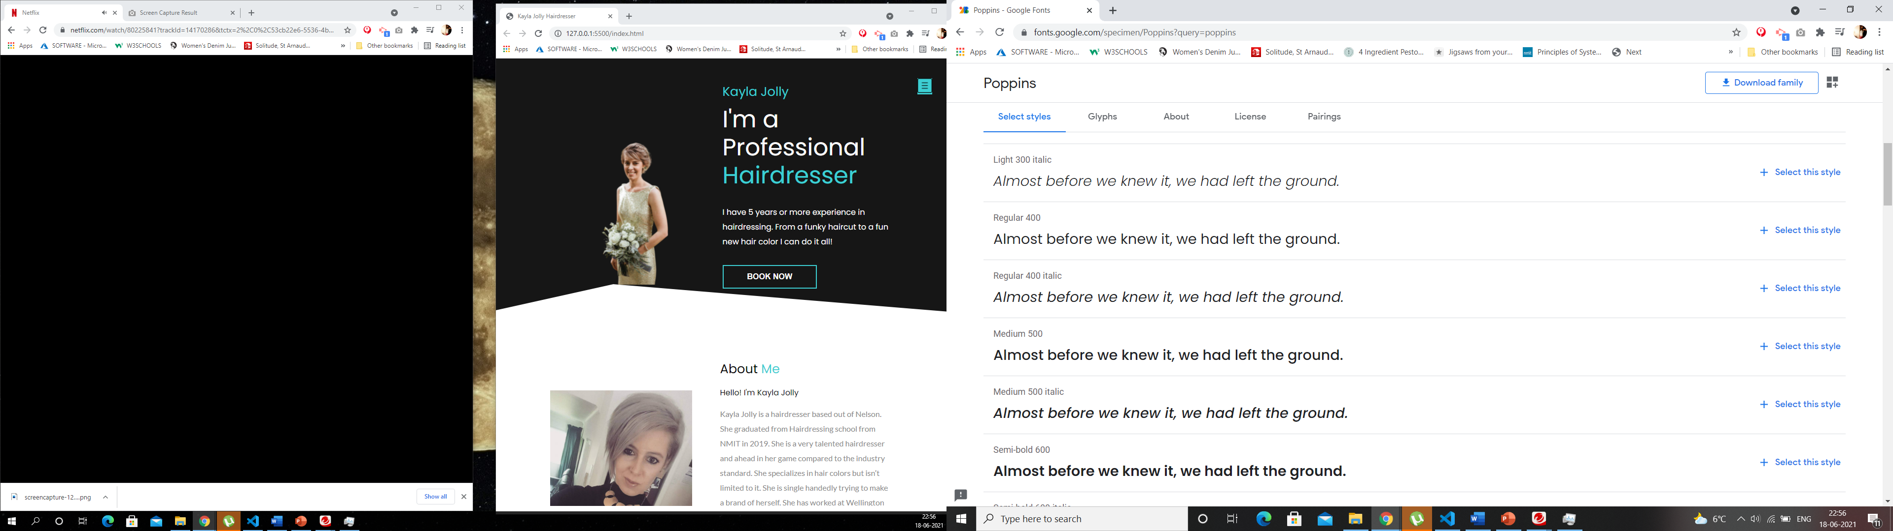
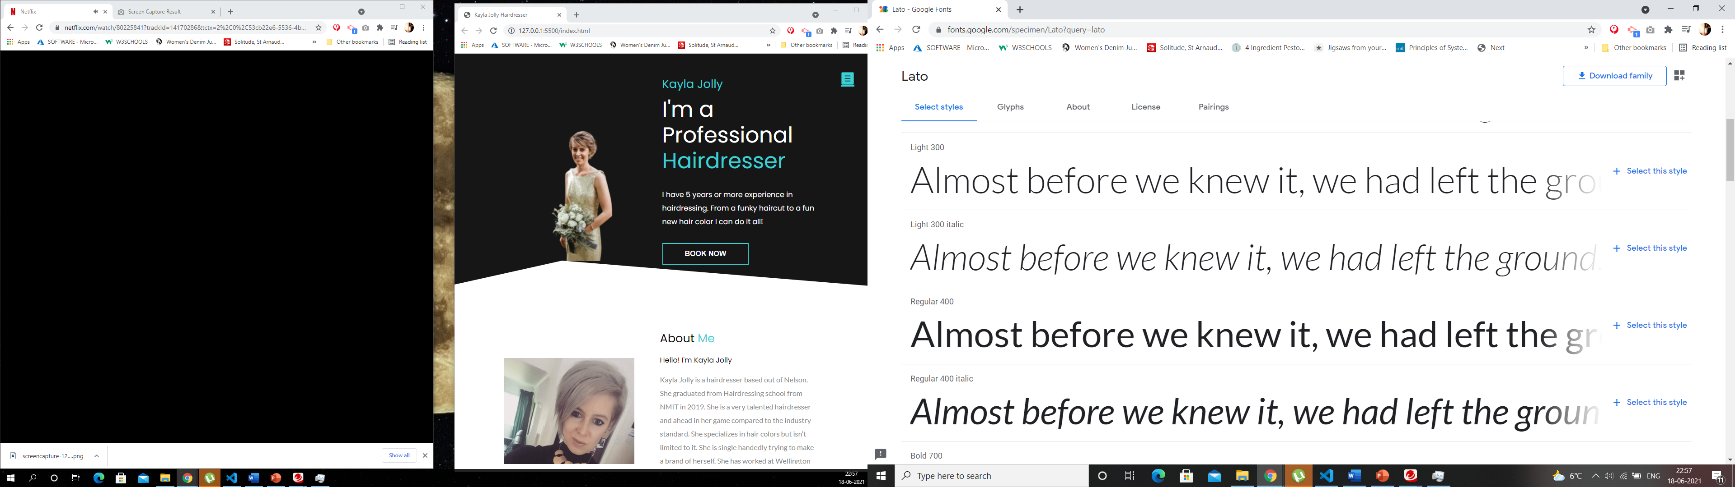
Font choices
I have used Google font to download my choices of fonts. I have used two times of fonts, Poppins and Lato. The body of the website is written in Poppins, and the fall over font is sans-serif incase Poppins doesn’t work. The about me section, the paragraph section for services, the text on the cards, the book an appointment paragraph all uses the Lato fonts. The reason I chose these fonts is because I thought they go well with the colors of the website, and it feels gender neutral just like the brand.

Slide 4









SVG choices
Kayla Jolly only has Facebook and Instagram for her brand at this stage, but she will be making a Linkedin profile soon, hence I have also added a linked plugin. The plugins are under the about me section after the paragraph finishes.
I have used https://www.flaticon.com/ to download the icons.

Slide 5
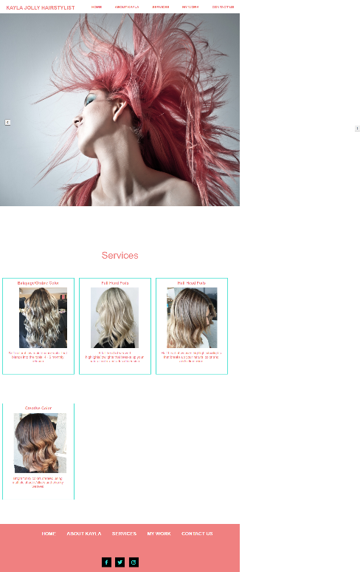
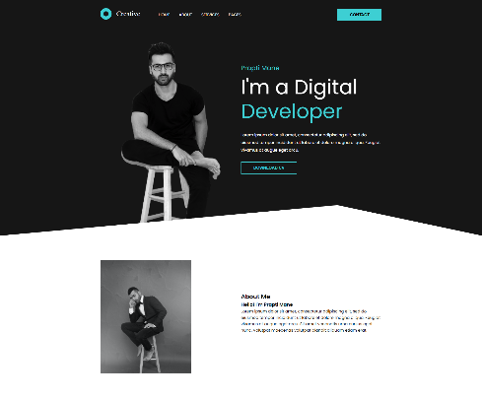
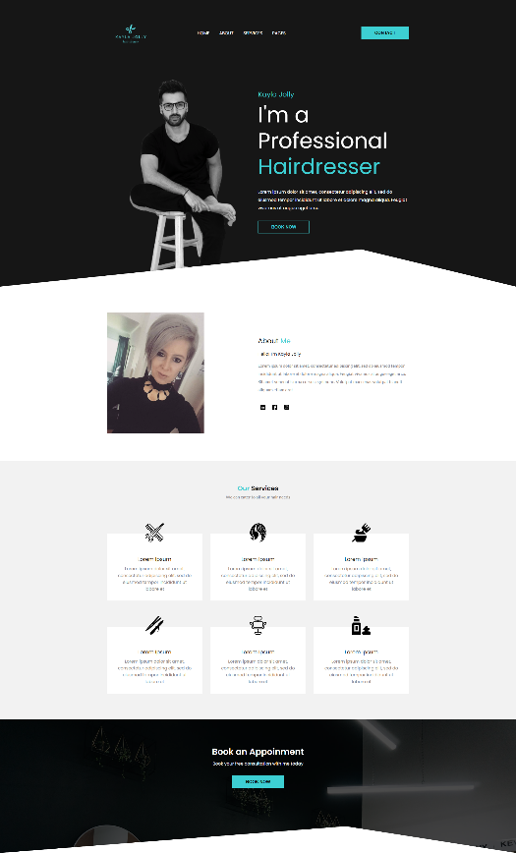
Evolving design
The design of the website is a mixture of what we had 2 years ago, I mixed it up with the new portfolio design that I found online.
This is the link of the tutorial that helped me build this website.
https://www.youtube.com/watch?v=8r1MHZec4Hc
I have changed the design slightly, but not too much cause it was perfect with what my client is looking for, hence I have changed a few things.
On the left you can see the screenshots of the evolving stage of the design. The logo for the website was created using Canva. Couple of years ago Kayla Jolly didn’t want a logo but this time she decided she want a logo for the website hence I used Canva to create the logo.
As you can see 2 years ago we were using Turquoise and Pink but we have realized the previous design was extra pink which promoted that it’s a feminine brand but now Kayla has also started barbering side of things which is gender neutral hence the pink is not needed anymore.
In the final design we have changed the Banner image this image will be changed again once Kayla gets a photoshoot done, as well as the about me image
As far as the CSS is concerned I have created

Slide 6
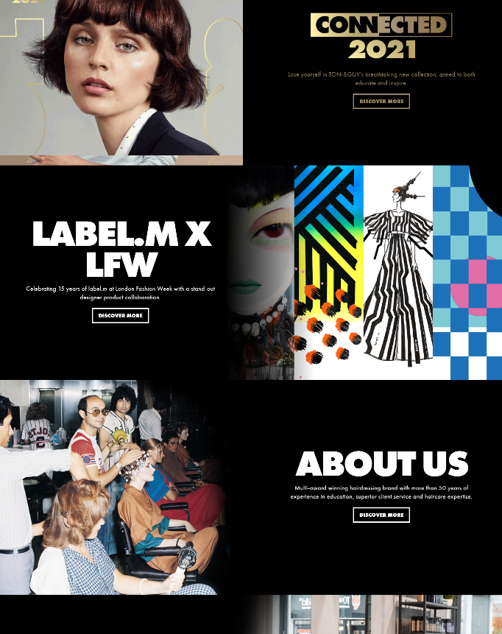
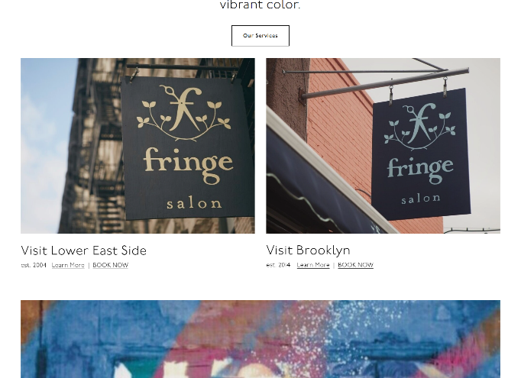
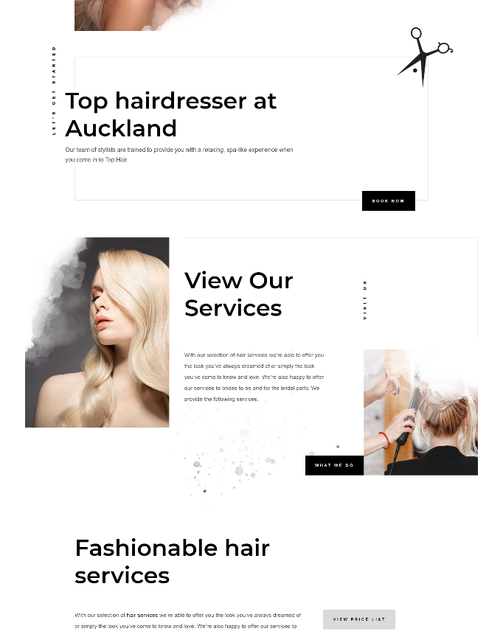
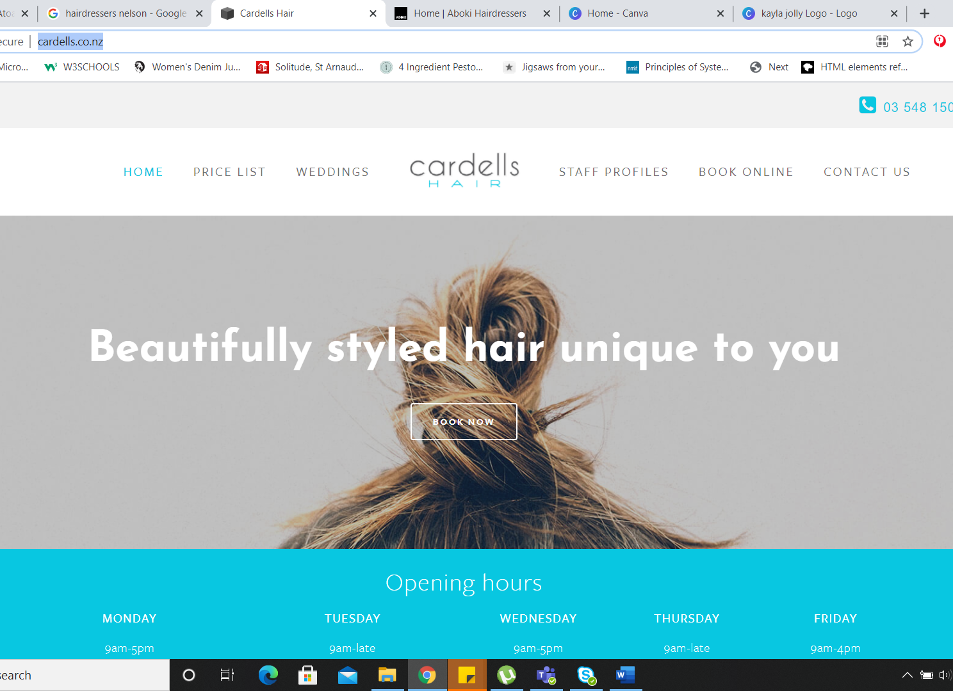
Inspiration
This is the link to the video tutorial that I used to create my website, since the layout was very similar to what I was looking for my one-page website, it worked out well. Especially since this guy does not give source code and more importantly, he explains everything step by step which is quite useful/helpful. The tutorial is not in English.
These are some of the design inspirations that helped me with the design and the colors used in the website as well showed me how important using the correct font is for the website. These websites are very high end and would also require that kind of budget but if you compare my design to these websites, it looks pretty professional build too. These are not a single page application websites.

Slide 7
UXD Analysis
The best part about this website is that it is a One page Application, which means the user does not need to browse across different pages to hunt for information, it is all accessible on the landing page. The colors of the website are popping enough to attract the users attention but not so much that it would be annoying to look at after a certain point. The buttons of the website are big enough so the user would not struggle with it on a smaller device or any other device. The website works well in all devices as it is fully responsive. The design is modern yet basic, there is no guess work involved when it comes to using this website. There are some interactive elements on the website which give the website a nice touch, the hover and svg icons which are used for services make the website look professionally made. The client was very happy with this layout of the website, including the color palette that I suggested. The images used for my work section is the clients real work, which according to me makes the website look attractive and the message about the brand is conveyed with more power. The images which are used are just taken off of Kayla Jolly’s facebook for now since she hasn’t done a professional shoot. I have informed her about the resolution and the orientation of the images required. The original design is by this Indian web developer who tutorial has been cited in this report.

Slide 8
UXD Analysis
One of the best things about this website is the slider for the reviews, this is a nice modern feature which helps the users read the reviews of the brand without overpowering them with too much information and this helps avoid negative comments, incase we keep it open for the users to comment. Hence it is better if we list these comments on our own. I have changed a few things from the original design, as per what I thought would work better for the brand. Span on the heading of the website, which I have in different colors makes the website look more attractive and it immediately takes your eyes to the headings. Everything on the website is very well aligned. Although the footer of the website is not something the users are going to like when they come to this website, but that can be changed before we make the website live. The important things that the users are going to look at when they come to this website is the services that the brand provides and their previous work to make an informed decision, both these things are well placed on the website and the user should’ve no problem navigating to these using the nav bar. One of the other drawbacks of the website is that I have put the links on the buttons on their text instead of on the entire button hence if the user clicks on the empty space, nothing will happen hence they need to click on the text inside the button for the navigation to work correctly.

Slide 9
Professional practices and standards
This is one of the most important things especially when you’re working with clients directly and do not have a project manager as your point of contact. A client does not speak designer/developer lingo, they speak plain English and it is our responsibility to help them understand exactly what we need from them and what their requirements are before taking on the project. Projects can easily go over budget if the requirements are not established and stated clearly during the estimate stage. As a designer our responsibility is to figure out exactly how long a design/development time will be and only then commit to work. Always give the clients a clear picture, cause the clients can have some different expectations as compared to yours and then you do not want to not be able to fulfil it, hence communication needs to be clear and straightforward. Be honest clients appreciate honesty. Make sure all your content etc has it’s copyright in place. When you make a website make sure to put your copyright at the bottom of it.
Customer Service

Slide 10
Your final design
I think I have succeeded in capturing the theme of the project which was a hairdressing website. The website does exactly that gives out information about my client Kayla Jolly shows what all services she offers as well as displays her existing work, which helps clients book in with her. The idea for this project was developed with my client as she was very clear what she wanted from her website. When we had this idea 2 years ago it was focused around women wanting their hair done, but Kayla also expanded her work profile by getting into barbering and now it is a gender neutral project hence we have changed the entire look and feel of the website. We have decided to drop the pink tones which were used previously from this website. We went through some of the best websites on the web and Kayla decided for the first deployment she would like a simple website and as the brand and clientele grows we can add in some more features for eg: a booking system etc. I did not particularly look at an artists or art movements or cultures since this is a basic hair dressing website, but I did look at some of the top websites in American and NZ to check the differences in audiences. I am definitely more handon when it comes to HTML & CSS. I would like to learn more of Javascript as I reckon I can do better with JS.

Slide 11
Your final design
Talking about my final piece of design/website, the elements are arranged in a good manner they’re spread out and nothing is overlapping which is good for a user especially to navigate through the website. I reckon the existing composition of the design/website is good. Speaking of foreground and background I do have a background element on the website which has an image and I have increased the opacity on the picture to show the text for my Book an Appointment section, it makes it look quite modern.
The one thing I struggled with for this assessment was the footer of the website, I still haven’t fixed it but before we make this website live I will fix the footer and make it slightly different. Something that was also quite tough was putting in the media queries to make the website responsive. I still do not have a working nav bar in my mobile view but that is something I will need to work on some more and have it completely fixed as my client will not be happy with it at all. I was struggling to figure out a solution for it.
Here is the link to my website https://github.com/praptimane26/Portfolio-Online

Slide 12
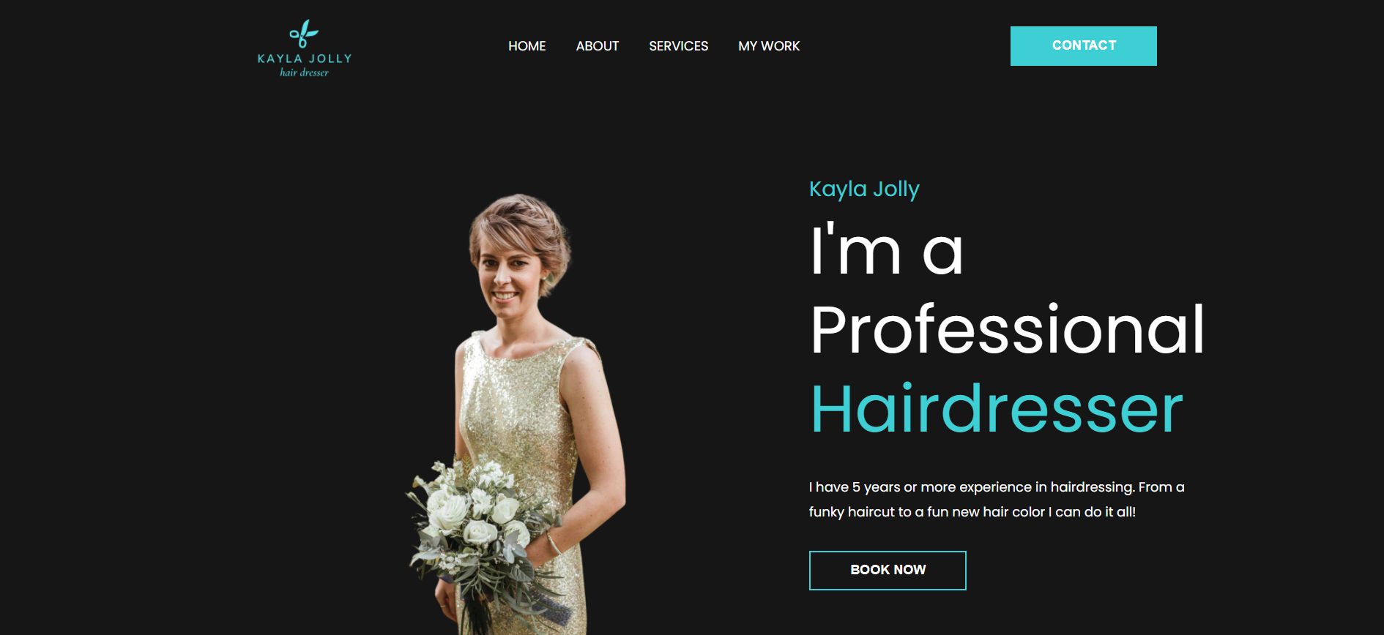
Banner Section

Slide 13
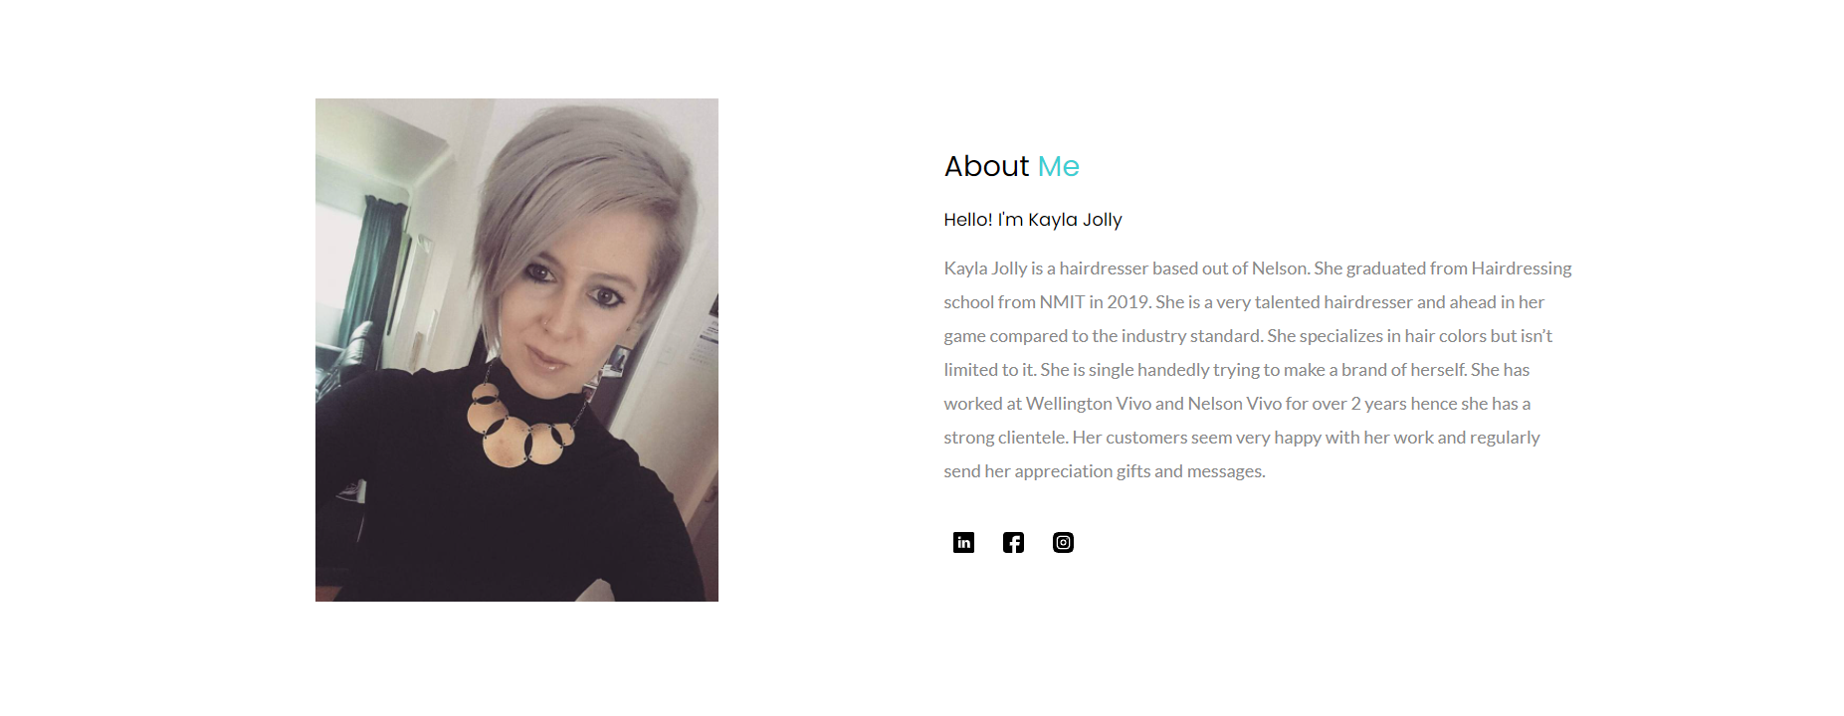
About Me Section

Slide 14
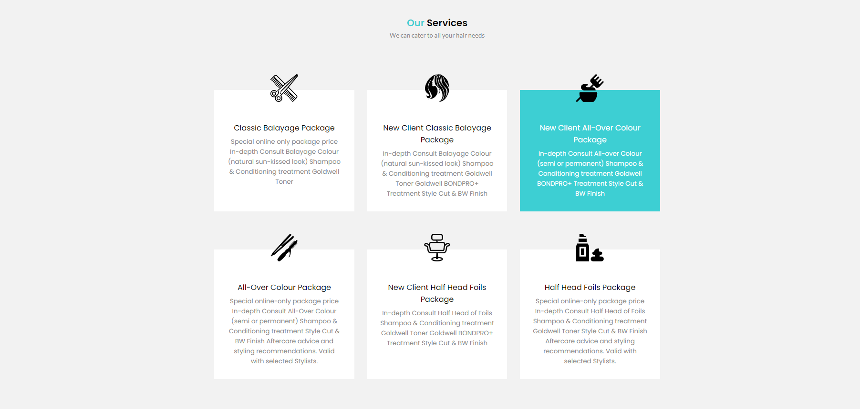
Our Services Section

Slide 15
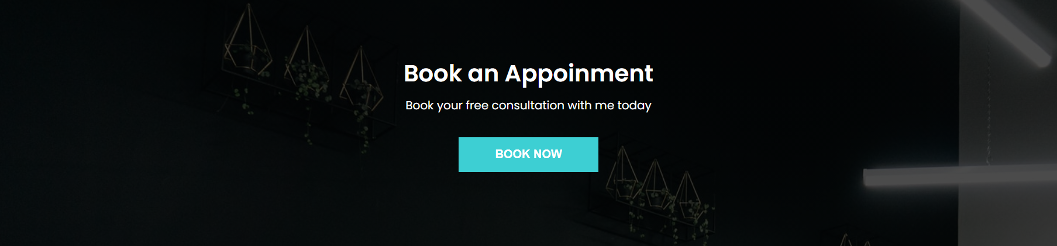
Book an Appointment Section

Slide 16
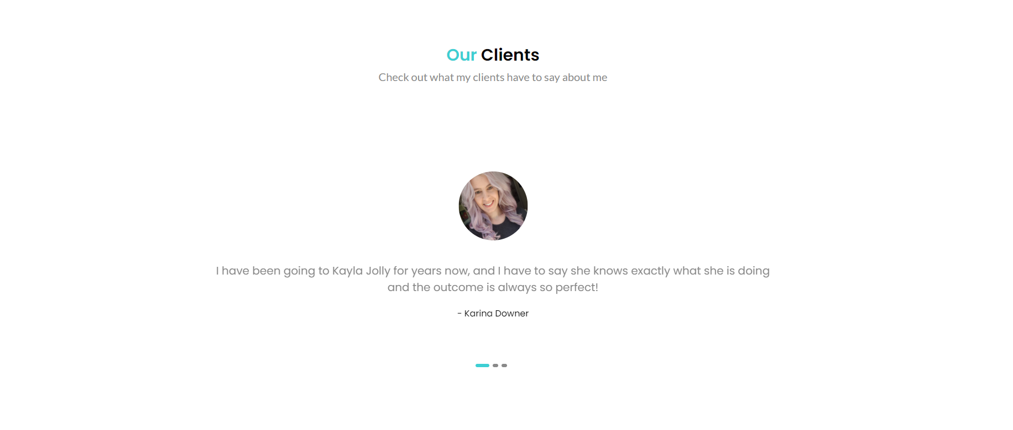
Our Clients Section

Slide 17
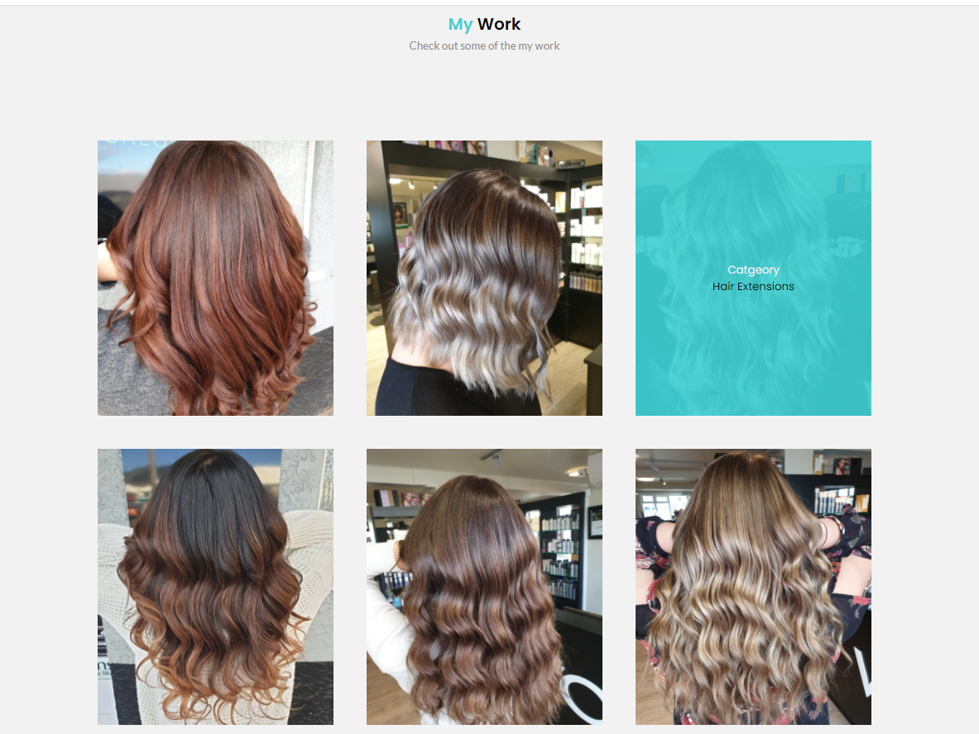
My Work Section

Slide 18
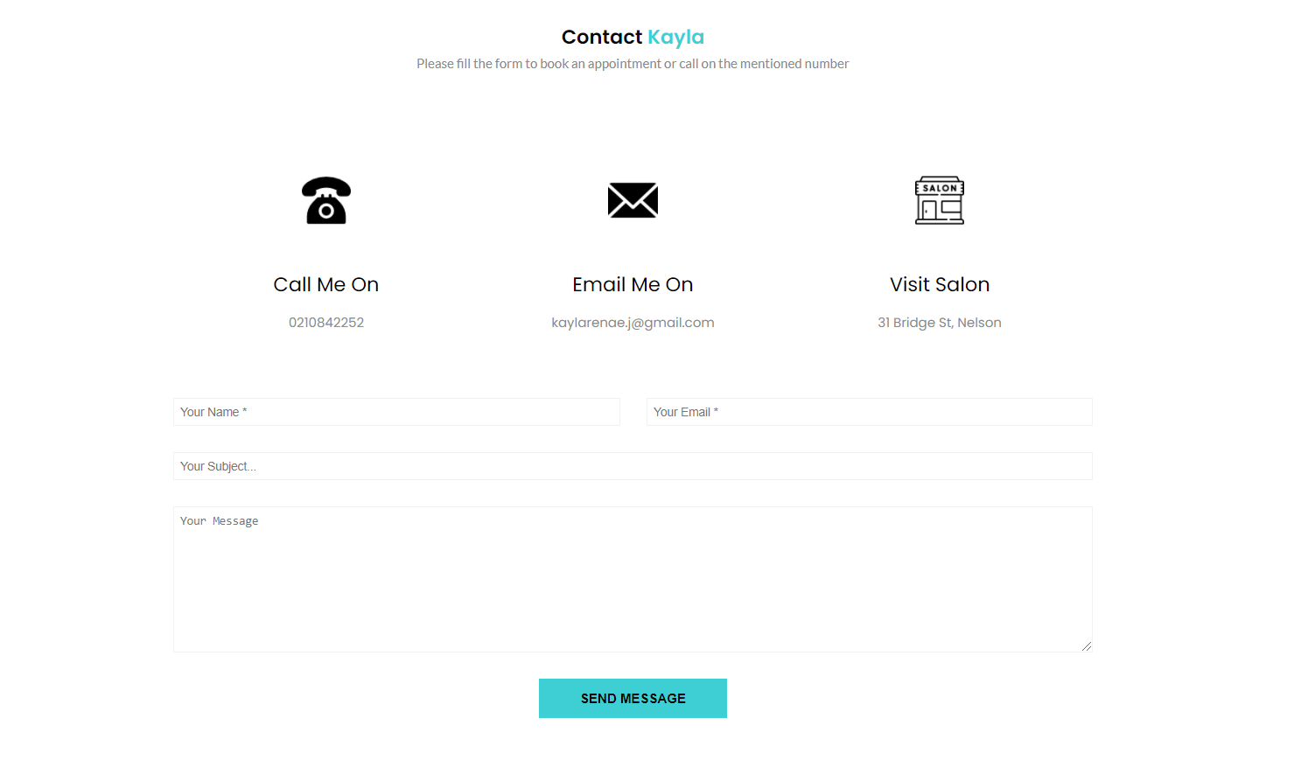
Contact Section

Slide 19
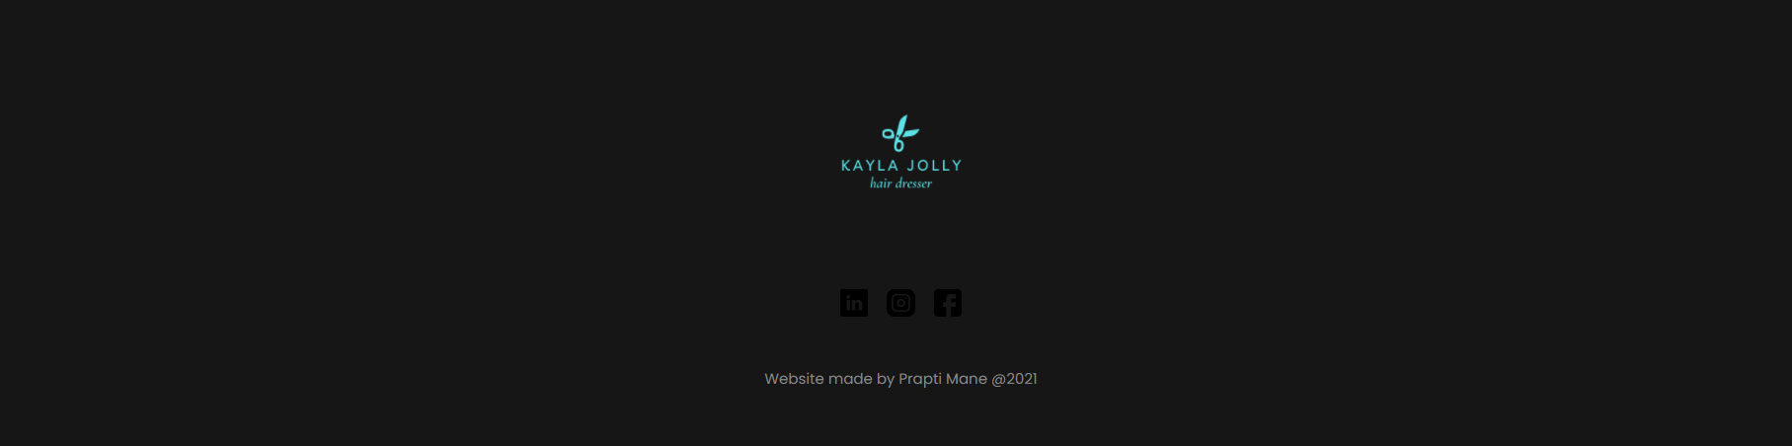
Footer Section

Slide 20
Bibliography
Fringe salon ny. (n.d.). Fringe Salon Ny. Retrieved June 19, 2021, from https://www.fringeny.com
TONI&GUY. (n.d.). Retrieved June 19, 2021, from https://toniandguy.com
Muse Salon and Spa. (n.d.). Muse Salon and Spa. Retrieved June 19, 2021, from https://www.musesalonandspa.com
Talented Hairdressers in Auckland | Newmarket Top Hairdresser. (n.d.). Top Hair. Retrieved June 19, 2021, from https://tophair.co.nz/
Coder’s Gyan. (2020, February 14). Create a Personal Portfolio website using html and css step by step in Hindi in 2020 🔥🔥 Part 1. https://www.youtube.com/watch?v=8r1MHZec4Hc

